Slide 1
MaterialX: Standard Surface to glTF Export Workflow
Autodesk Graphics Platform
Christian Robles
MSc. Computer Science, USC | linkedin.com/in/roblesch
Notes:
Hi, my name's Christian Robles.
I'm a Master's student at the University of Southern California studying Computer Science and Computer Graphics.
This summer I worked with the Autodesk Graphics Platform team.
Today I'm going to talk about supporting Standard Surface to glTF Export in MaterialX.
In this presentation I'll discuss what each of these pieces are, the gaps we identified for this project, and how we solved those problems.

Slide 2
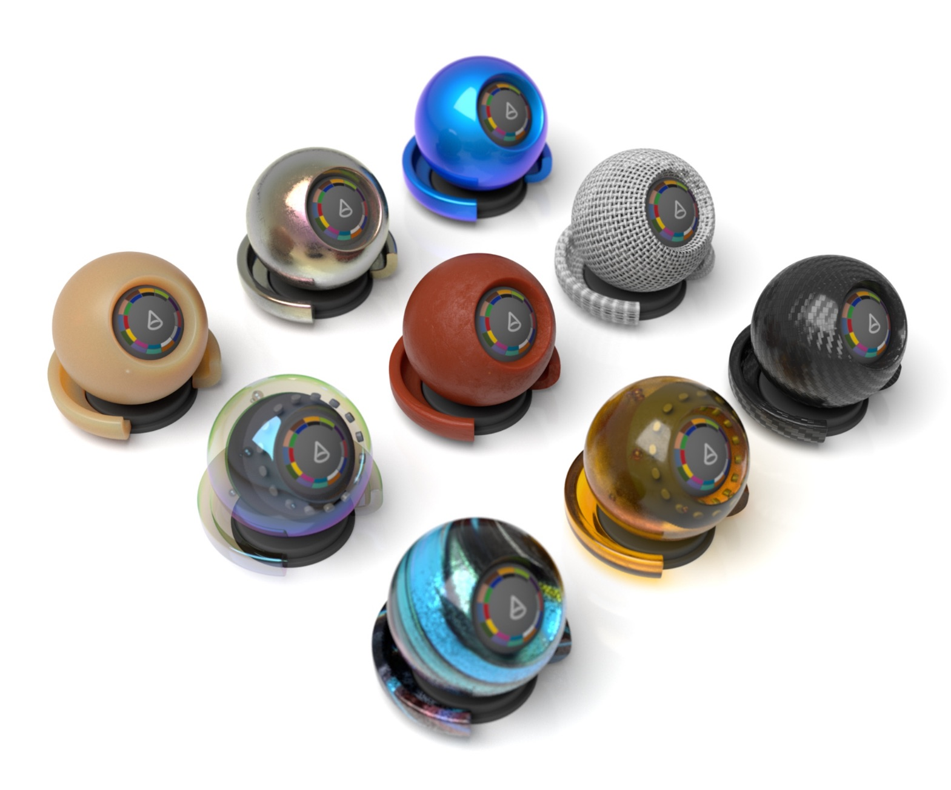
Agenda
Problem Overview
Stakeholders & Impact
Implementation
Results
Key Takeaways

Slide 3

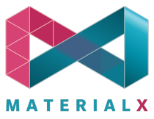
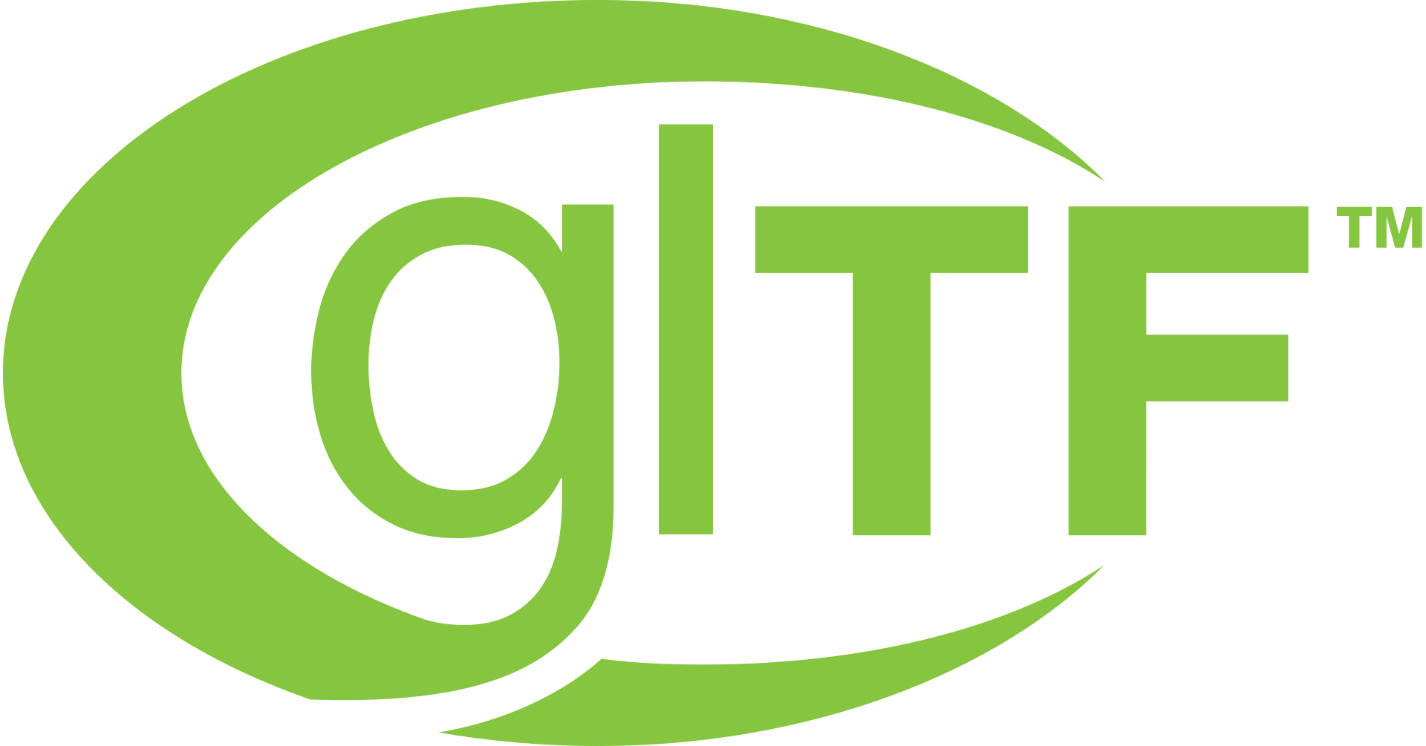


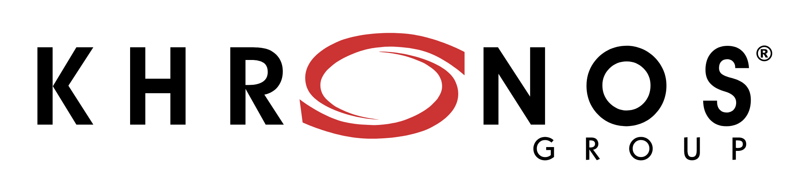
Problem Overview
Material Model
Material Encoding
Material Transmission
Notes:
There are three key standards in this project:
Autodesk Standard Surface,
Academy Software Foundation's MaterialX,
and the Khronos Group's glTF.
Standard Surface and glTF are Material Models - they define how a material looks.
MaterialX is an open standard for material encoding.
This means that it encodes material models like Standard Surface and glTF in a way that makes it easy to edit and transmit them.
One of my teammates has a pancake analogy; Standard Surface and glTF are like two different recipes for pancakes, and MaterialX is a cookbook; they might each disagree about what ingredients make a pancake, but MaterialX will still store them. MaterialX won’t make you pancakes, but it will give you the instructions you need to make them yourself.
Each of these components are positioned to become standard tools in their use-cases, but interoperability is difficult.
So, if we can improve interoperability, we enable collaboration in the open standards community and prove support for each of these platforms.
So the goal of our work is to support a workflow to translate materials from Standard Surface to glTF using MaterialX.

Slide 4
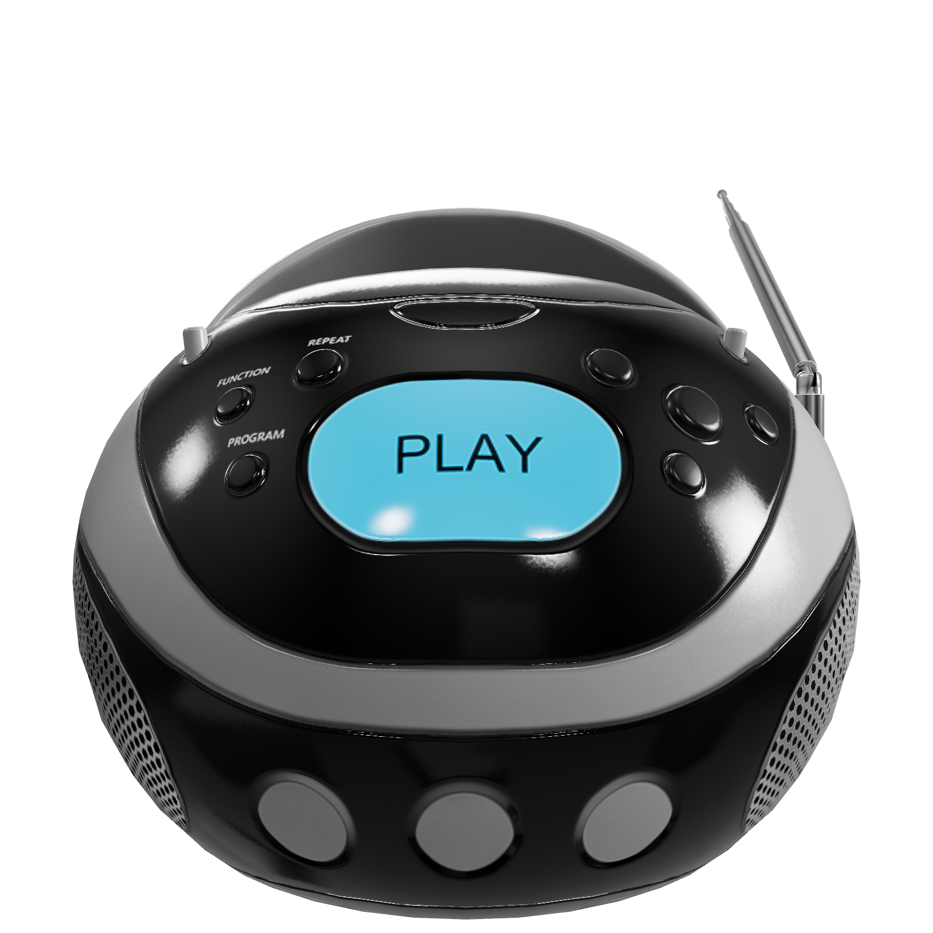


Stakeholders & Impact
De-couple export from internal components
Streamlines export for customers
Production use-case for MaterialX
Foster interoperability ecosystem
First-class content delivery format
glTF sample models, Khronos Group
Notes:
Our stakeholders for this work are the owners of each standard.
For Autodesk, this work creates an opportunity to de-couple export from internal components and into the open source community.
Additionally, it streamlines export for our customers.
For the Academy Software Foundation, our work can provide a production use-case for MaterialX and foster broader interoperability in the material standard ecosystem.
Finally, for the Khronos Group, glTF export improves glTF's visibility as a first-class content delivery format.
For all of these stakeholders, an export workflow strengthens support for each framework as a standard format in its use-case across the open materials community.

Slide 5
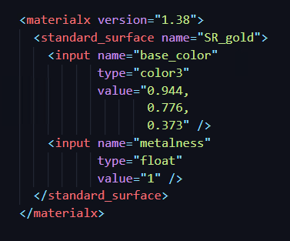
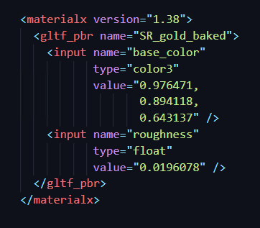
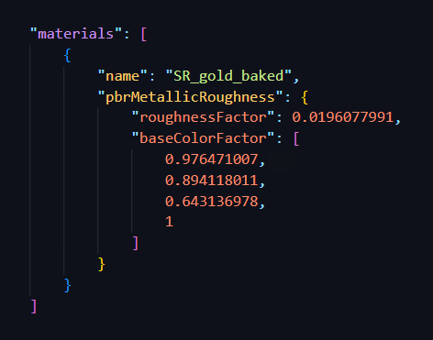

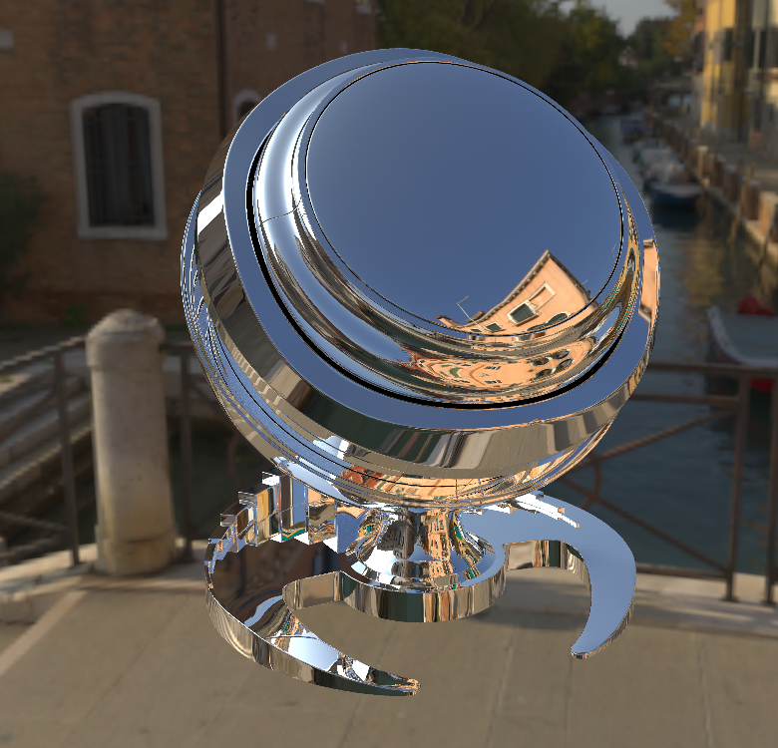

Implementation
Standard Surface *.mtlx
glTF PBR *.mtlx
glTF PBR *.gltf
Translate
Export
Render
Render
Render
Notes:
To solve this problem, I created two pipelines.
First is the translation pipeline.
The translation pipeline is the data layer that converts Standard Surface materials to glTF.
It relies on translation and export.
I implemented Translation as a MaterialX nodegraph that takes a Standard Surface document and maps it to a glTF PBR document.
I've also implemented Export as a MaterialX library that takes our translated glTF document and converts it to native glTF standard JSON.
The second pipeline is the render pipeline.
The render pipeline consumes our batches of translated materials and renders them using Autodesk Arnold and Dassault's dspbr path tracer.
Below, you can see some reference renders from our pipelines; left and center rendered in Arnold,
and Right is rendered with Dassault's path tracer

Slide 6
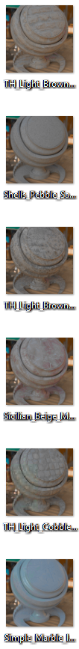
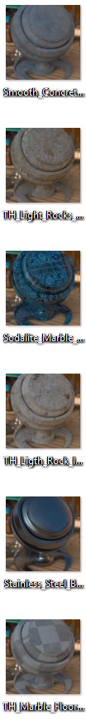
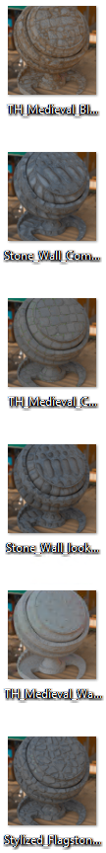
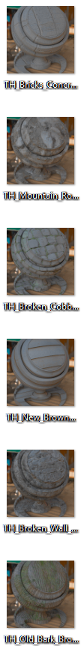
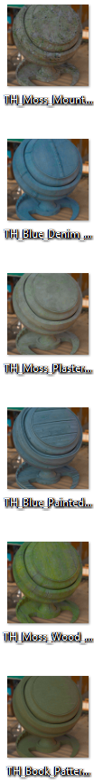
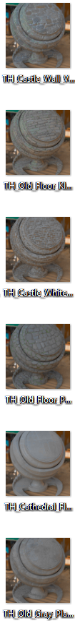
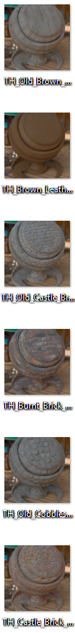
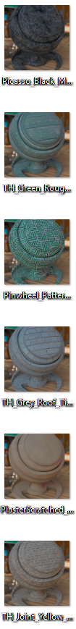
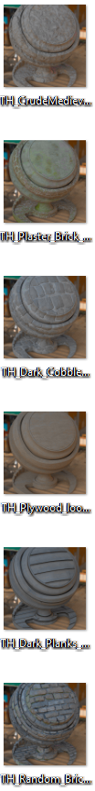
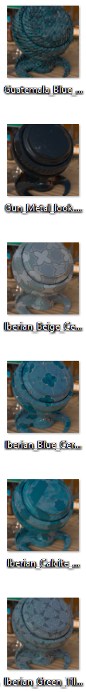
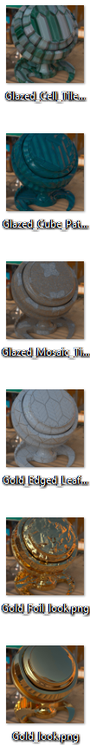
Results
Maps core features
Test set of 350+ materials
Presented at ASWF Open Source Days
Reusable pipeline assets
Roadmap for Internal & Open Source contribution
Notes:
Now for some results!
Our translation nodegraph covers the core features of gltf pbr, with further support enabled by
ongoing ratifications within the standards community.
Our test pipeline translates and renders images for a test set of over 300 materials from AMD's GPUOPEN material set.
This work was presented by Bernard Kwok at ASWF's Open Source Days, an annual conference covering current work across the open source landscape.
Our pipeline assets are reusable for other material translations.
We have a roadmap for internal and open source contribution of our work.

Slide 7

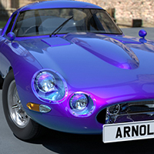
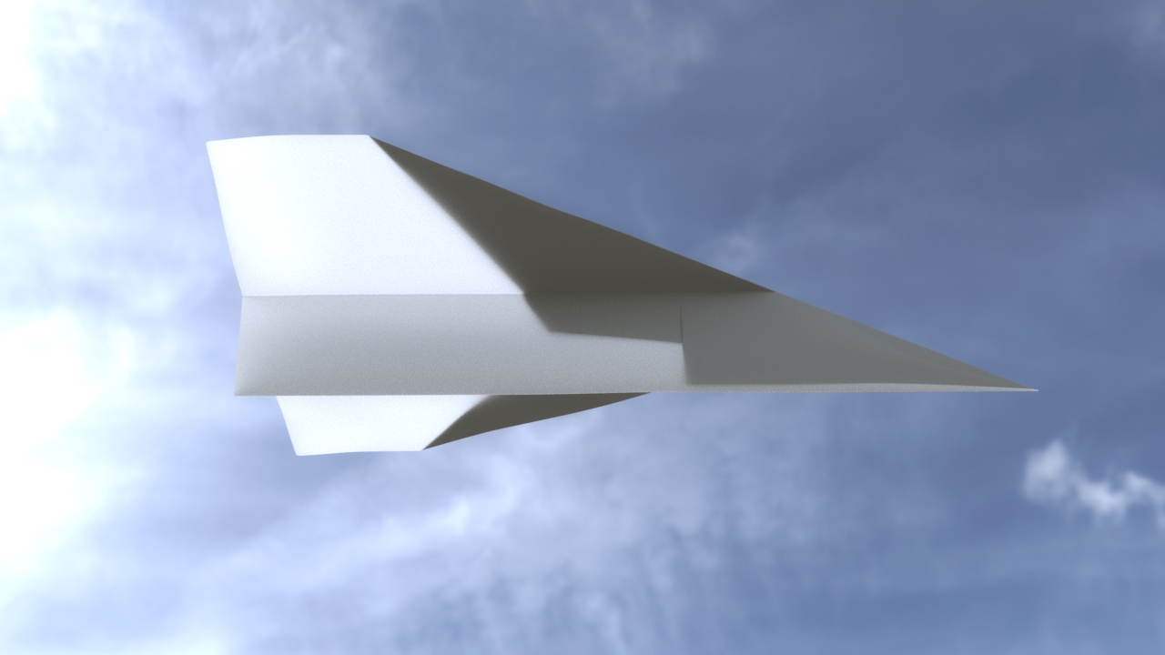
Learnings and Takeaways
Deep engagement with state-of-the-art
Collaborated with key contributors
Hands-on with many repositories
Contributing to Autodesk products
Thank You!
Sankar Ganesh, Manager
Nicolas Savva, Mentor
Standard Surface "Thin Film", Autodesk
Standard Surface Diffuse Transmission, Autodesk
Notes:
The greatest impact of this project was the sheer scale of the work - I got deep hands on experience
with a large chunk state-of-the-art technology in this problem space
I got face-time with key figures in the open standards community and got to engage with the Academy Software Foundation.
The work was very hands-on - each project had to be forked and edited for our use case – the only think that worked out of the box was Arnold.
Finally, I think it's a rare opportunity to contribute to work that has a path to production, so I think it's really to have done this for an intern project.
That's all from me, I'd like to give special thanks to my Manager Sankar and especially my mentor Nic, they were a
huge help this summer and I truly couldn't have done any of this without them. Thank you, and thank you all for taking the time to hear my presentation.

